Slide 1

The Deployment of Naloxone to Prevent Opiate Overdose Fatalities
Sgt. Geoff Kirkpatrick
And
Corporal Chris Dode
Your Police, Our Community

Slide 2
The Problem?
Oregon Statewide Drug Related Deaths (OSP Medical Examiner Program)
250
200
150
100
50
0
2003 2004 2005 2006 2007 2008 2009 2010 2011 2012 2013
Heroin Cocaine Meth Combo Total

Slide 3
Courtesy of Jackson County Medical Examiners Office

Slide 4
Drug Amount in Grams

Slide 5

The Real Problem
- Jackson County, Oregon population: 206,4312
- Average Opioid prescription per year: 250,000
- As a nation, the US is 4.6% of the world population but consumes 80% of the world supply of opioids…..

Slide 6
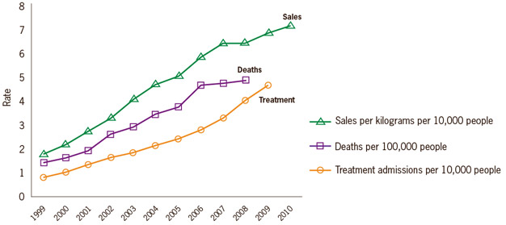
Rates of prescription painkiller sales, deaths and substance abuse treatment admissions (1999-2010)
SOURCES: National vital Statistics System, 1999-2008; Automation of Reports and Consolidated Orders System (ARCOS) of the DEA, 1999-2010; Treatment Episode Data Set, 1999-2009

Slide 7
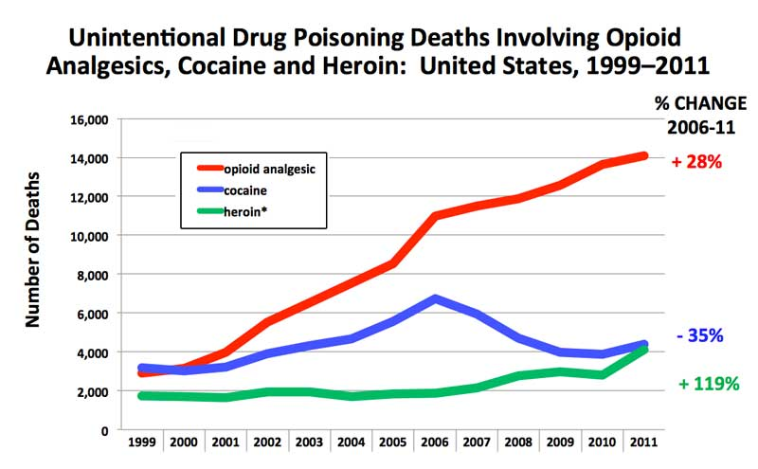
Overdose Deaths in the US

Slide 8
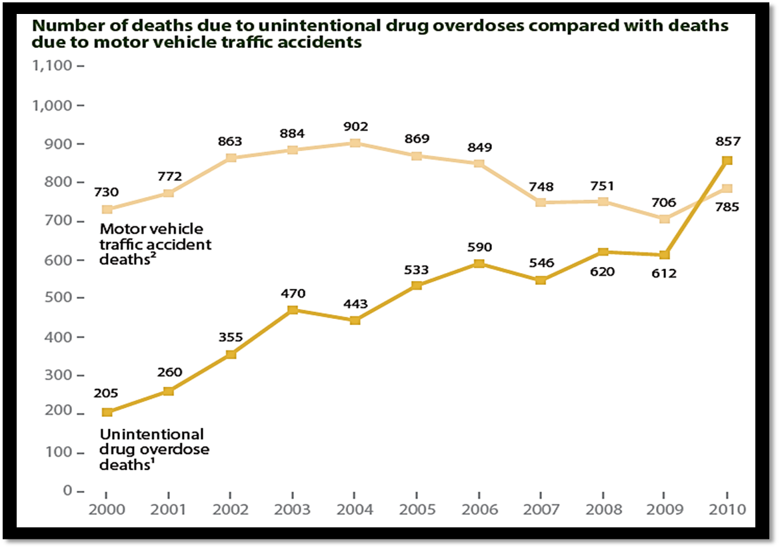
State of Kentucky Overdose Deaths vs Motor Vehicle accidents
SOURCE: Kentucky Health News

Slide 9
Naloxone

Slide 10
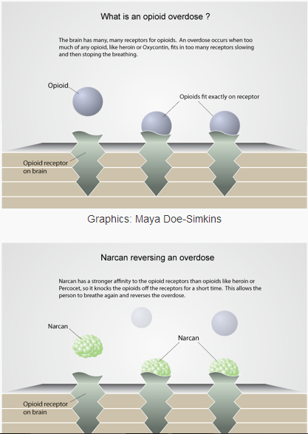

Slide 11
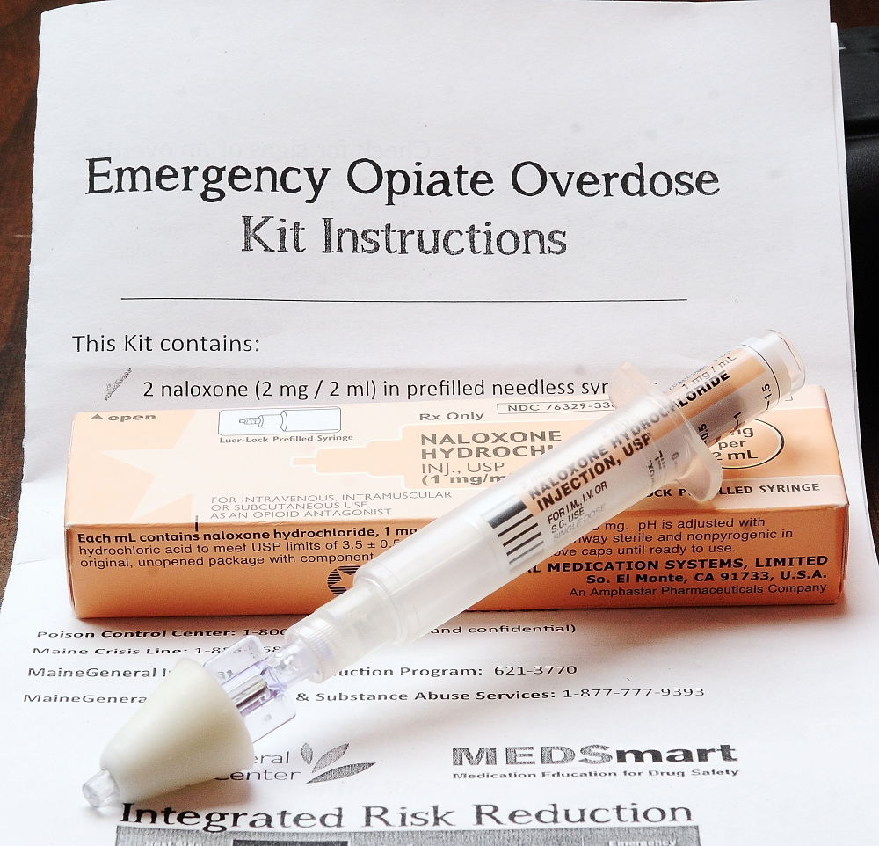

Slide 12
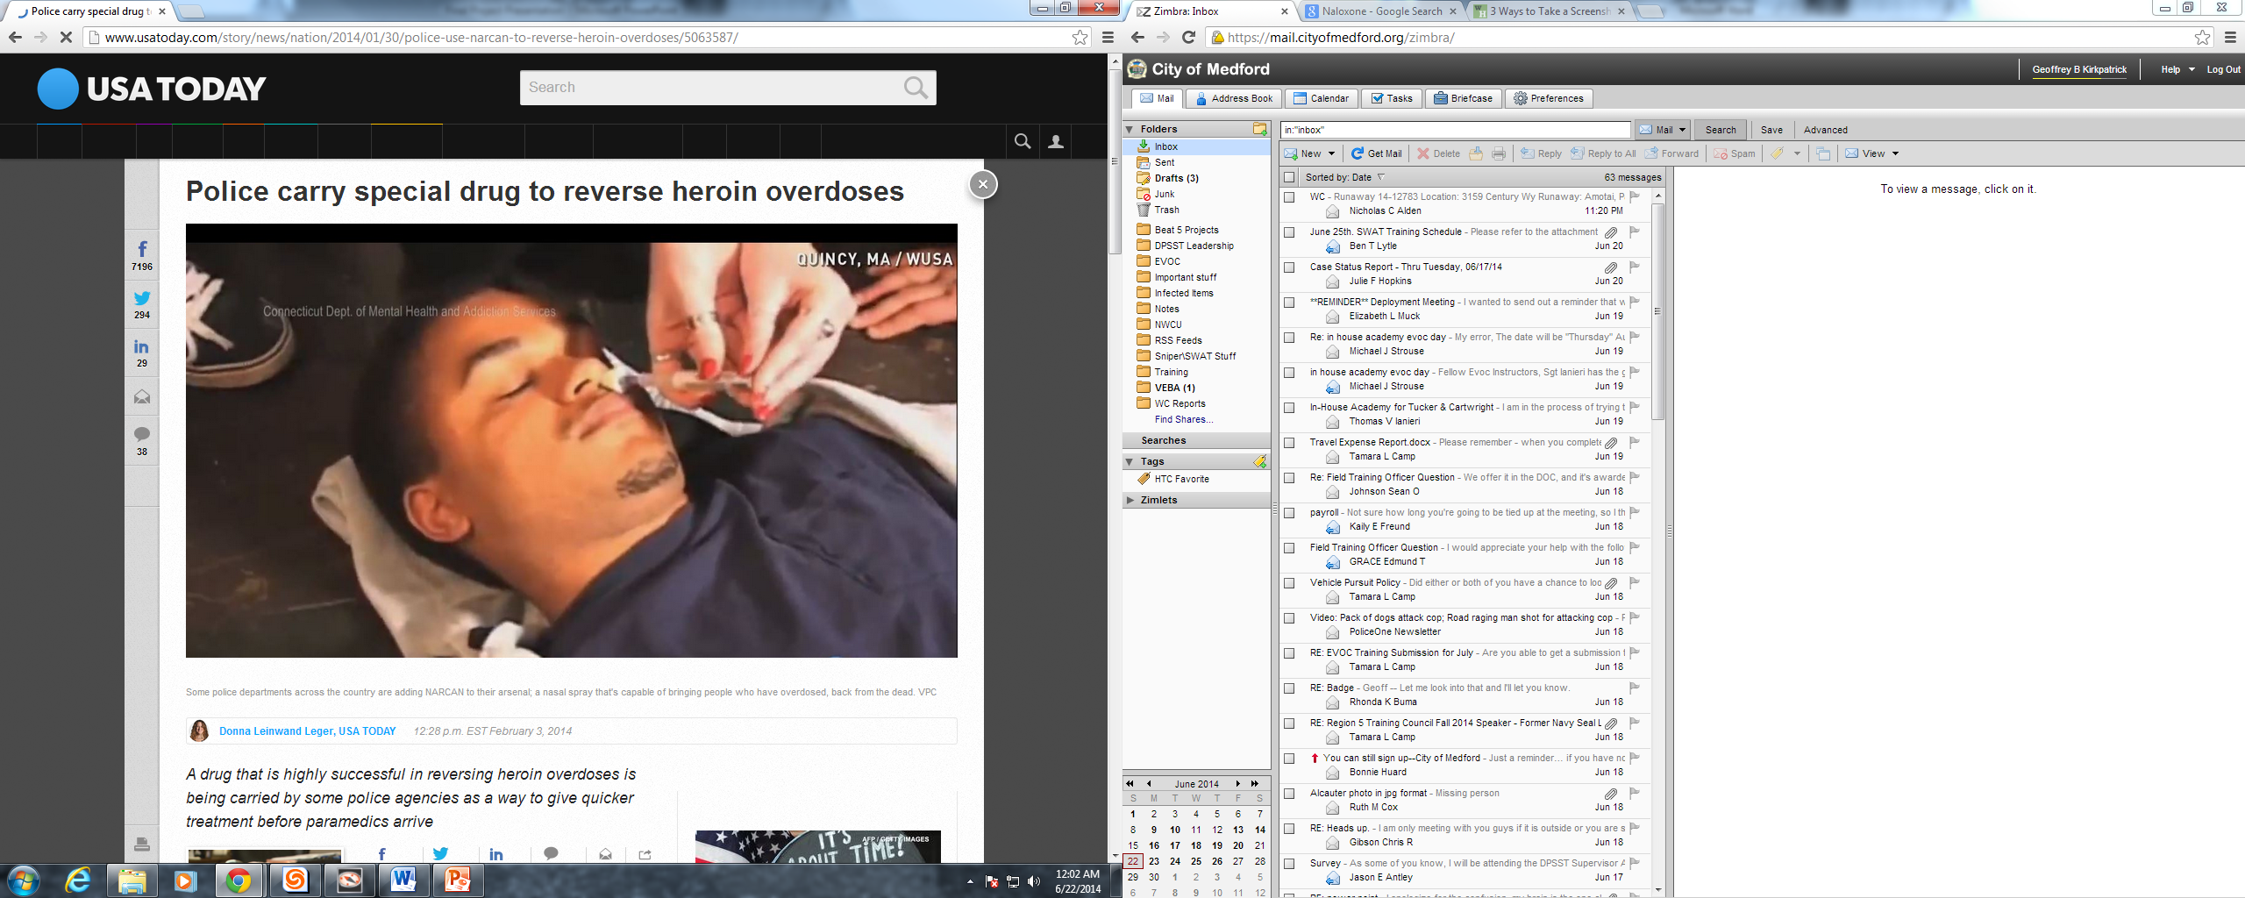
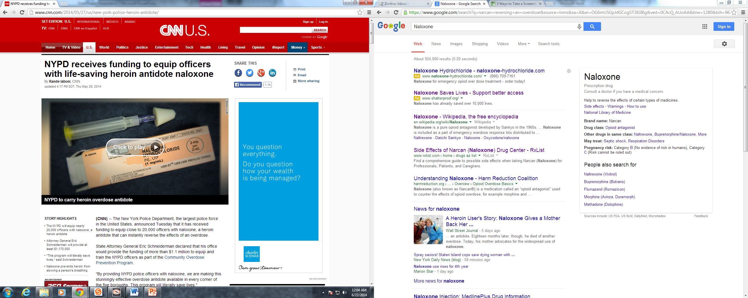
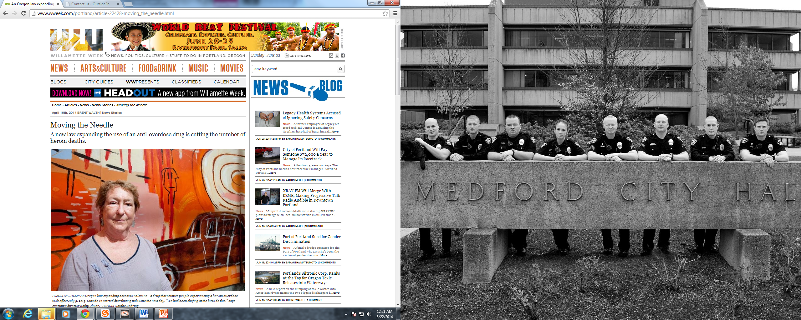
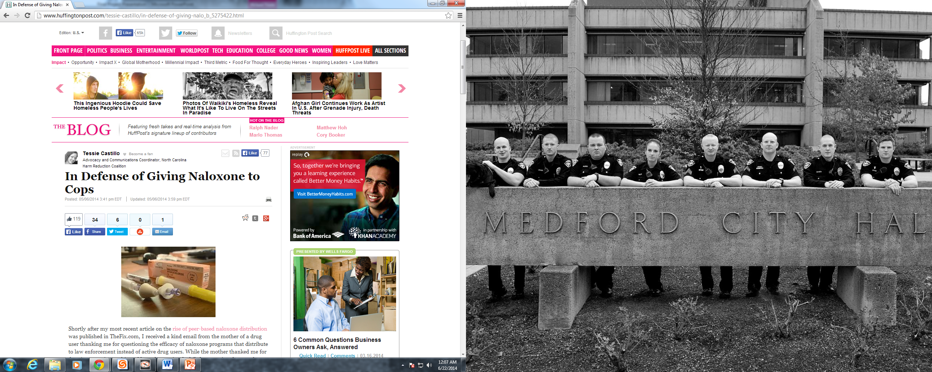
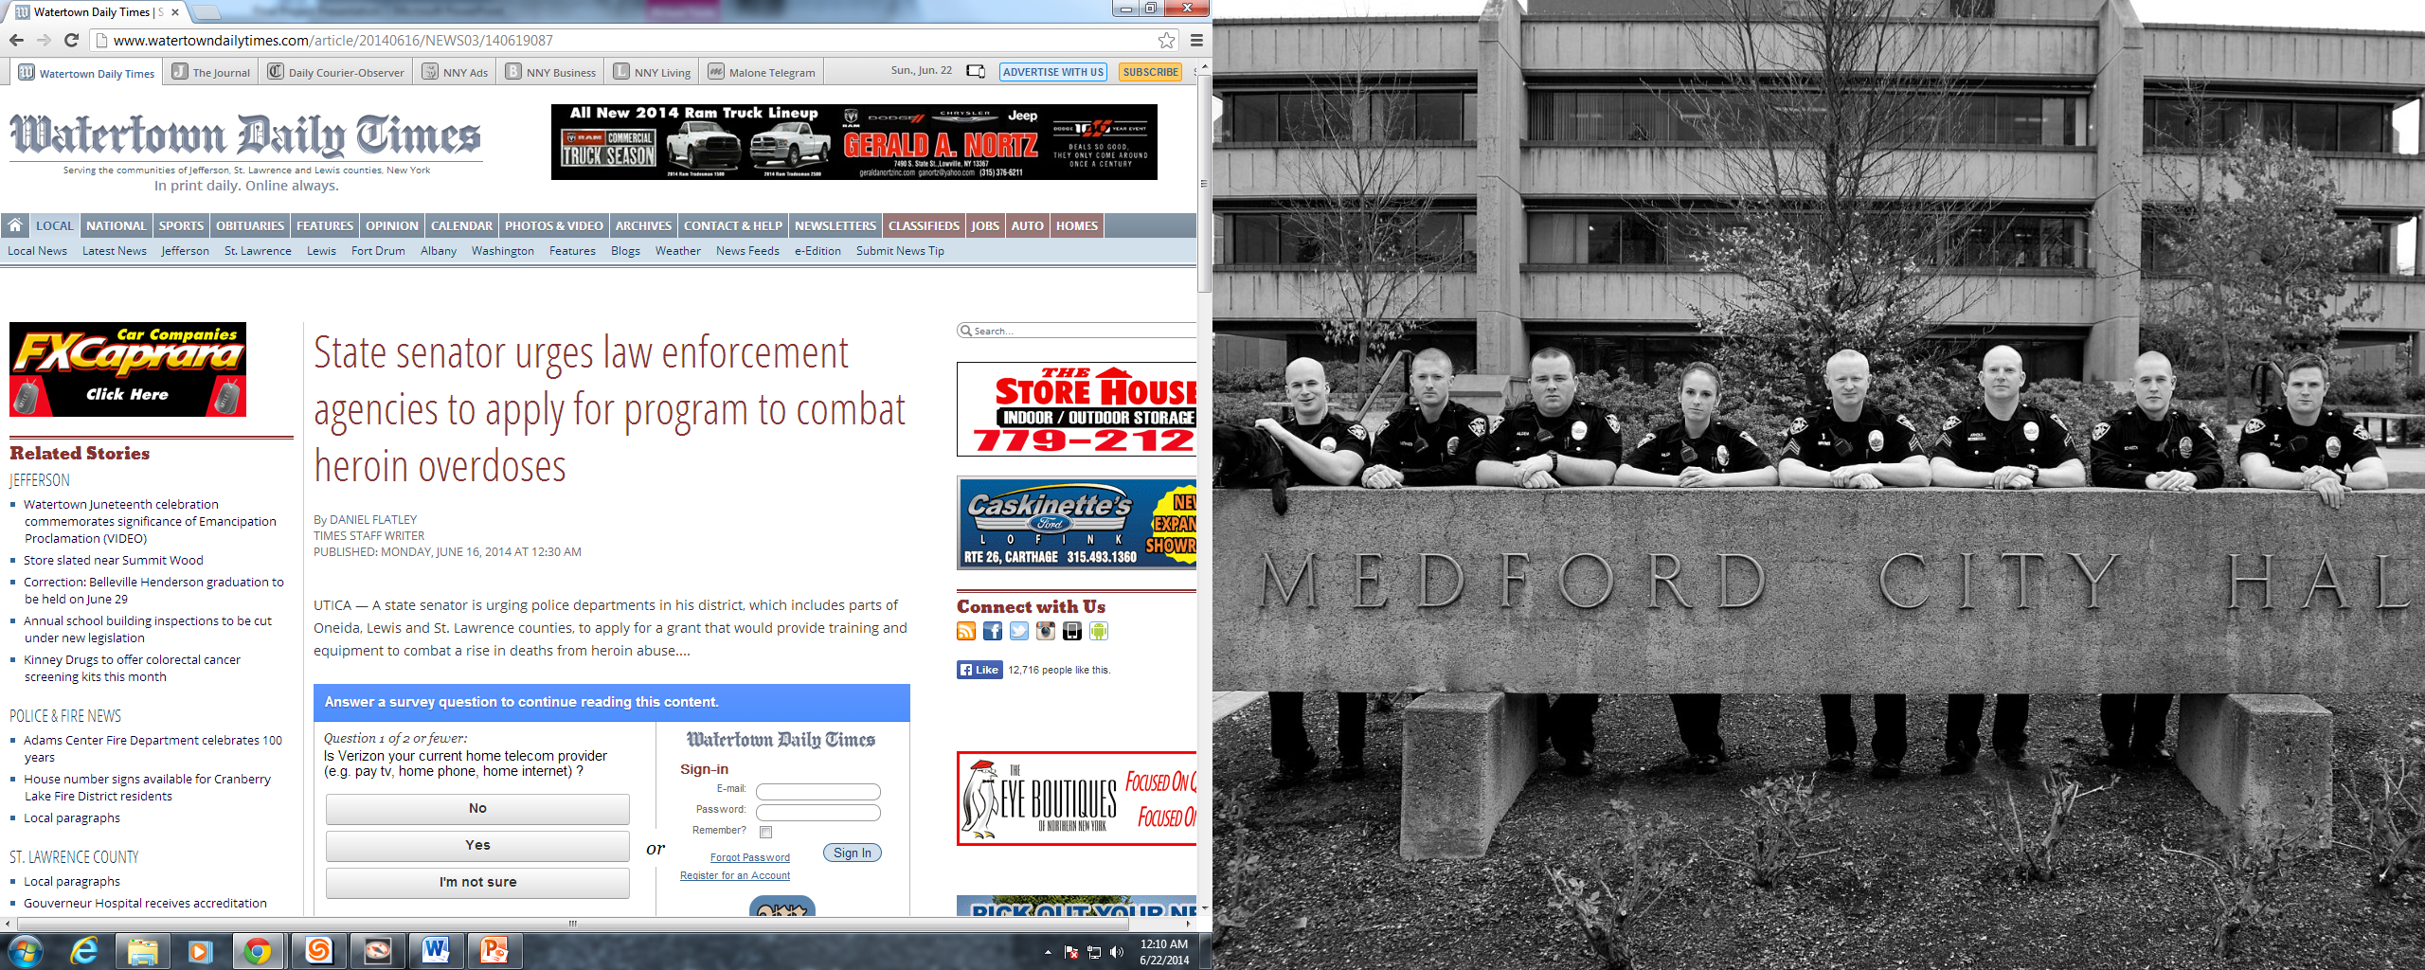
NALOXONE AND THE MEDIA

Slide 13
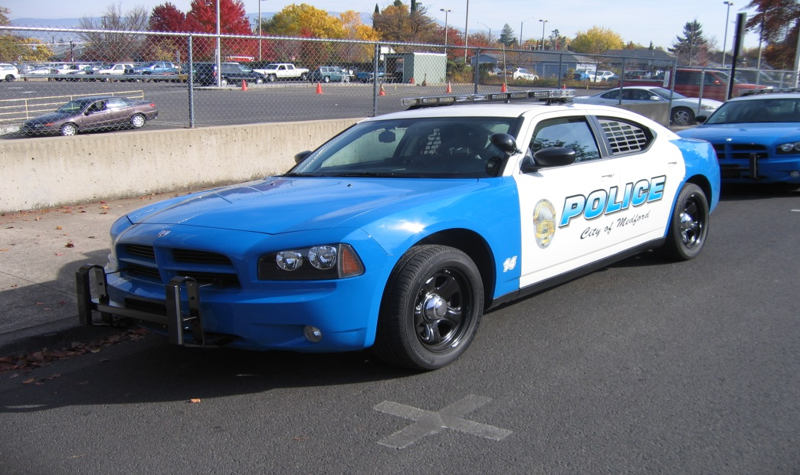
What is the SOLUTION?
-Fall of 2014 Approached by Medford PD Administration to implement a program
Medical oversight
How do we do it?
How do we pay for it?

Slide 14


Medical Oversight
Finding a physician to oversee our program was our biggest hurdle. Having a physician is a requirement under OAR.
Finding a physician
Approval
Our Solution?
Dr Jim Shames

Slide 15
How do we do it?
Authority under OAR

Slide 16

How do we do it?
Done in Conjunction with
Medford Fire Department
- Purchasing and Training
All officers trained in procedure

Slide 17

How do we do it?
Statement of Completion

Slide 18
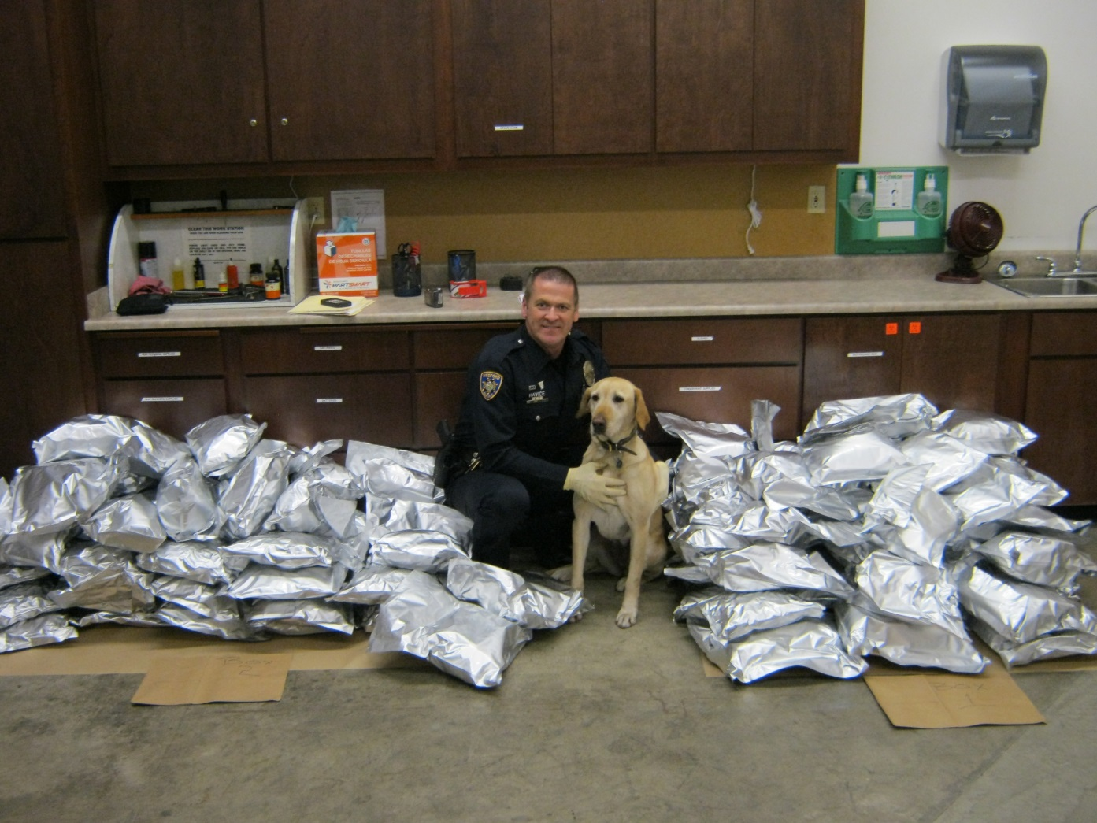
How do we do it?
Stored in patrol vehicles / Issued to Investigators

Slide 19

How do we pay for it?
Naloxone costs between $50 and $60 a dose
Possible reimbursement from HIDTA
Talk of reimbursement / subsidy from
Oregon Attorney General’s Office

Slide 20
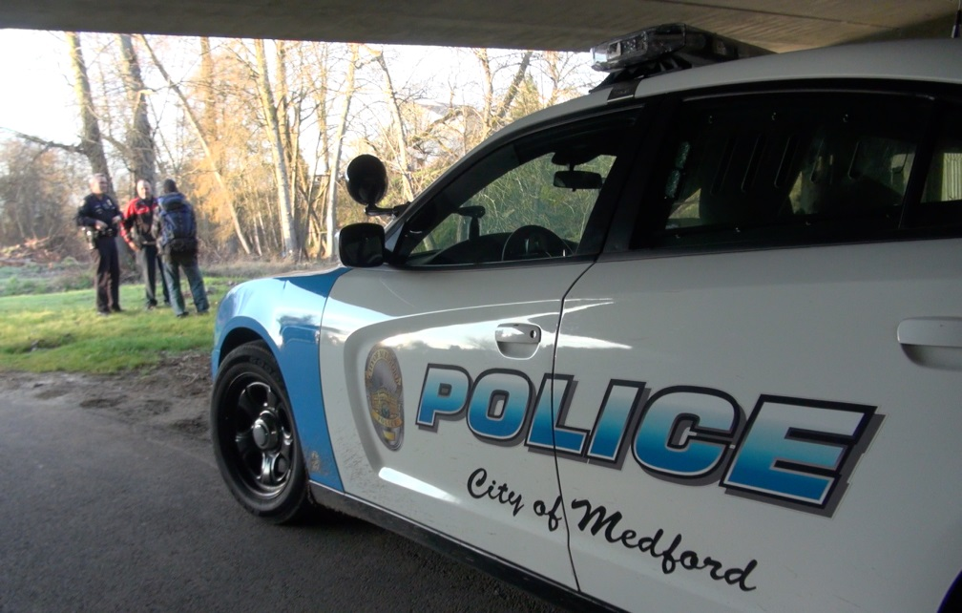
Medford PD Deployment
February 2015 department fully trained
First deployment on March 9th, 2015
Since program was initiated we have had a total of 9 deployments
8 of 9 had desired effect
-the one without desired
effect nothing was
observed, until IV
therapy/intervention

